Slide 1

Bank Marketing Prediction
Hernan Trujillo

Slide 2

01
Introduction

Slide 3

Introduction
The classification goal is to predict if the client will subscribe a term deposit, based on phone calls of a dataset from a Bank’ marketing team.

Slide 4

Term Deposit Product Prediction
Goal
Predict if a client will subscribe, or not, to a term deposit account.
Client
Bank Institution
Method
Direct marketing campaigns (phone calls)

Slide 5

Term Deposit Product Prediction
Focus
Current clients on the bank
Predict Target
Potential clients to subscribe.
Data source
Kaggle.com

Slide 6

02
Approach Classification

Slide 7

Data Information
Data Exploration
EDA
Feature Engineering

Slide 8
Data Details
40+ Datapoints 20+ Features
Conclusions
Processing
Modeling

Slide 9

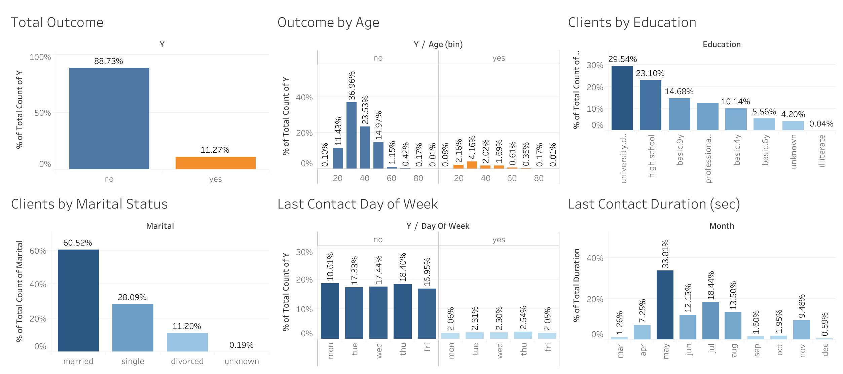
Preliminary Exploratory Data Analysis EDA

Slide 10
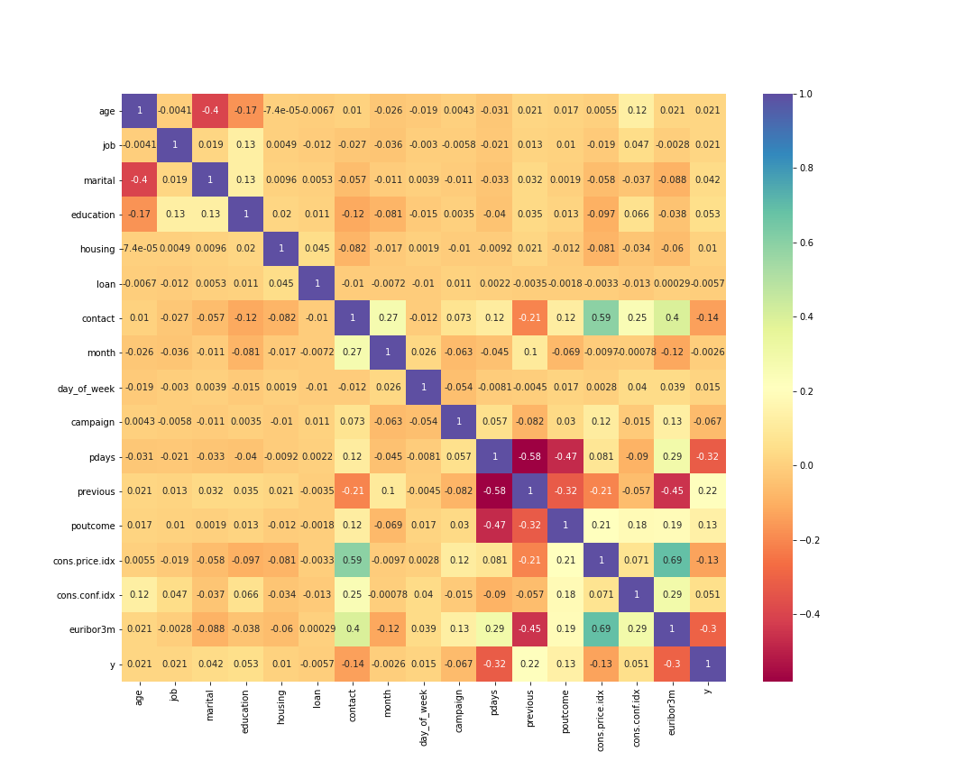

Feature Correlations

Slide 11

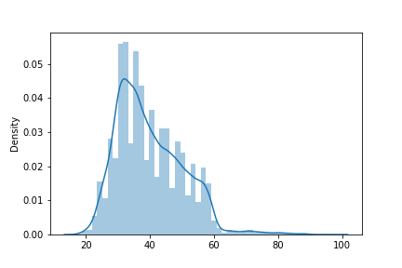
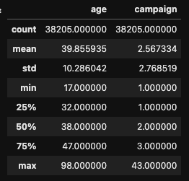
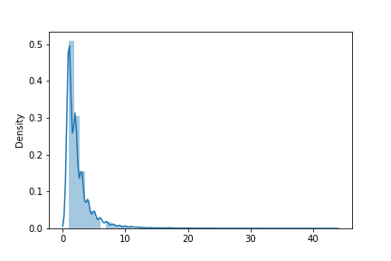
Feature Engineering Outliers
Age
Campaign

Slide 12
03
Results Modeling

Slide 13
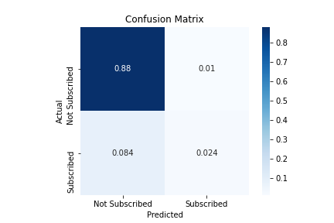

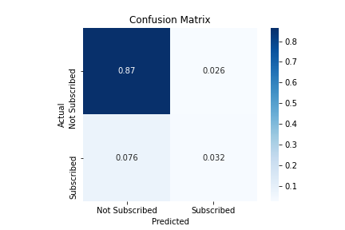
Confusion Matrix
01
02
03
Logistic Regression
Naïve Bayes
Random Forest

Slide 14
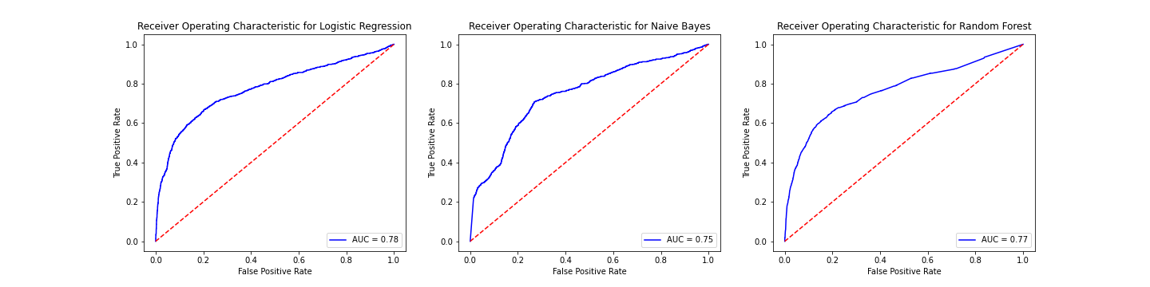
ROC Comparison

Slide 15

Classification Models Scores
Naive Bayes | F1 0.33
Base Model: Logistic Regression | F1 0.34
Logistic Regression (Class Weight) | F1 0.39
Random Forest | F1 0.38

Slide 16

F1=0.39
Conclusion:
Logistic Regression Model

Slide 17

Future work Additional Models
Model 1
Model 2
Model 3
KNN Model
Stochastic Gradient Descent Model
Support Vector Machine Model

Slide 18

Thanks!
hernantru943@gmail.com

